Slide 1
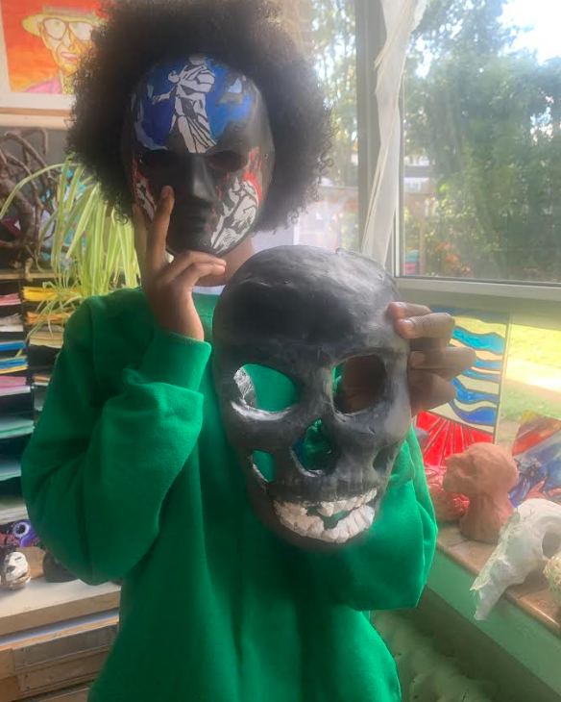
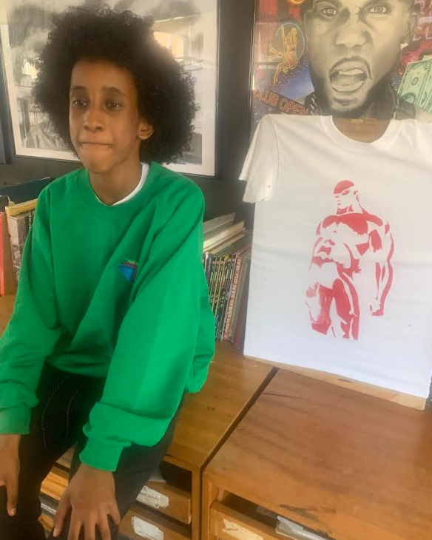

Israel’s Art Showcase
This week’s Student Spotlight proudly features Israel and his impressive array of artwork, including a custom screen-printed T-shirt, a 2D clay skull, and a detailed mask. Israel demonstrated fantastic artistic understanding as he confidently explained his creative process, skillfully using technical terms like screen, squeegee, and printing. Well done, Israel!

